Slide 1
Evaluation Metrics

Slide 2
Motivation
Suppose you have trained your machine learning model, How do you assess performance?
Performance of machine learning model can be assessed with the help of evaluation metrics.
Evaluation metrics helps to figure whether machine learning model is making accurate prediction, or whether it meets the desired objectives.
Choice of evaluation metrics depends on the types of task such as classification, regression, or clustering.

Slide 3
Classification Metrics
Different types of evaluation metrics are
Accuracy
Precision
Recall
F1-Score
Roc Curve (Receiver Operating Characteristics Curve)
AUC (Area under the ROC Curve)
“Consider Binary Classification problem, where we want to predict the Employee Churn. Let’s evaluate our model using various evaluation metrics”

Slide 4
Confusion Matrix
It is a tabular representation that summarizes the performance of a classification model by counting the number of correct and incorrect predictions.
Useful when dealing with binary classification problems.
Can also be extended to multi-class classification problems.
Recommended for imbalanced datasets.
Confusion matrix consists of four metrics:
True Positives (TP) → Total positive instances predicted as positive
True Negatives (TN) → Total negative instances predicted as Negative
False Positives (FP) → Negative instances incorrectly predicted as +ve
False Negatives (FN) → Positive instances incorrectly predicted as -ve

Slide 5
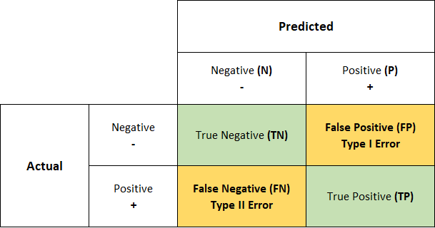
Confusion Matrix
False Positive is also called as Type I Error
False Negative is also called as Type II Error

Slide 6
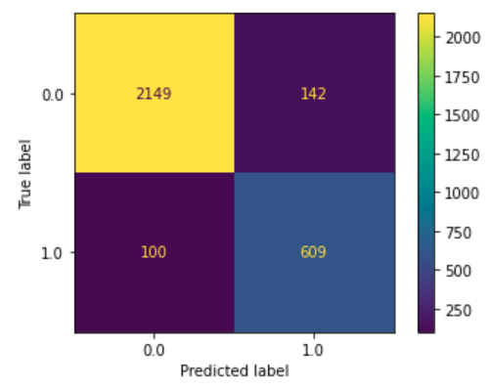
1. Accuracy
TN = 2149
FP = 142
FN = 100
TP = 609
It is the ratio of correctly predicted instances to the total instances
Accuracy = (TP + TN) / (TN + FP + FN + TP)
= 0.91
Accuracy is commonly used metric when the class distribution is balanced

Slide 7
2. Precision
TN = 2149
FP = 142
FN = 100
TP = 609
Precision is a measure of how many of the positive predictions made by the model are actually correct.
Precision = TP / (FP + TP)
= 0.81
Good choice of metric when you care a lot about False positives
Example: Medical Screening, Drug Testing

Slide 8
3. Recall / TPR / Sensitivity
TN = 2149
FP = 142
FN = 100
TP = 609
TPR stands for True Positive Rate
Measures the proportion of actual positive instances that are correctly identified by the model.
Recall = TP / (FN + TP)
= 0.85
Good choice of metric when you care a lot about False Negatives
Example: Fraud Detection

Slide 9
4. F1-Score
Precision = 0.81
Recall = 0.85
F1-Score is the harmonic mean of precision and recall (sensitivity)
Useful when you care about both precision and recall
Value in range 0 to 1
2 * (Precision * Recall)
F1-Score = —---------------------------
Precision + Recall
= 0.82

Slide 10
5. False Positive Rate
TN = 2149
FP = 142
FN = 100
TP = 609
False positive Rate is the ratio of false positives to the total number of actual negatives
FPR = FP / (TN + FP)
= 0.0619
Useful metrics when the cost of False positives is significant.
Medical Screening, Drug Testing

Slide 11
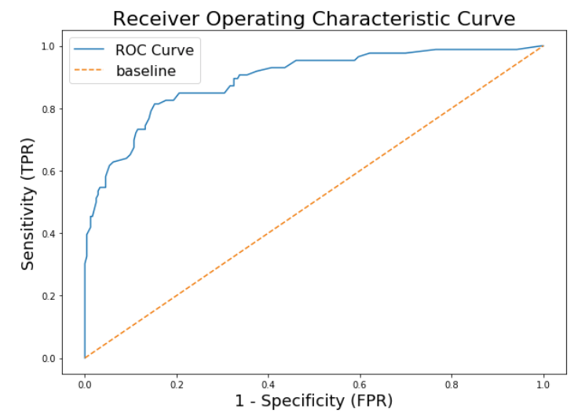
6. ROC Curve
Stands for Receiver Operating Characteristics Curve
ROC is curve is the plot between True positive rate (recall) against the false positive rate at various thresholds.
Higher the AUC score better the
Classifier is.
AUC stands for Area under the Curve.
AUC ranges in between 0 to 1
0 means poor classifier
1 means perfect classifier
Useful: Imbalance Data, Different thresholds needs to be explored in decision making.

